Slide 1
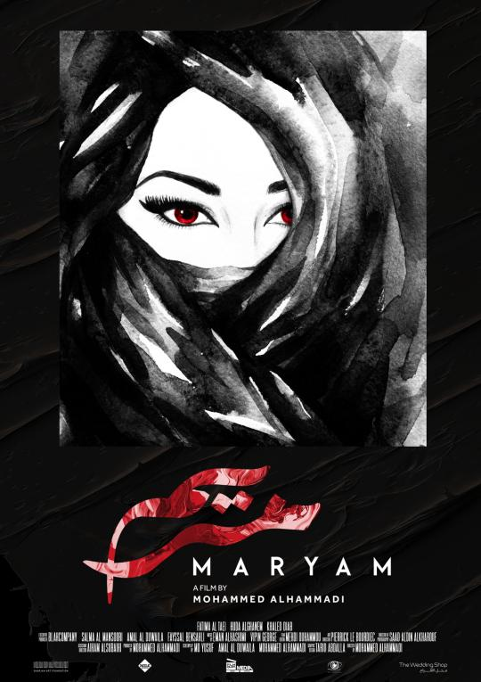

Slide 2
MARYAM
Directed and Produced By MOHAMMED AHMED ALHAMMADI
Written By MO YUSUF, AMAL AL DUWAILA, MOHAMMED ALHAMMADI
Starring
FATIMA AL TAEI, HUDA ALGHANEM, KHALED DIAB
DIRECTOR OF PHOTOGRAPHY: SAAD ALDIN ALKHAROUF/
GRAPHIC DESIGNER: TARIQ ABDALLA/
EXECUTIVE PRODUCER: BLAHCOMPANY, AMAL AL DUWAILA, SALMA AL MANSOORI, FAYSSAL BENSAHLI /
MUSIC: EMAN ALHASHIMI, VIPIN GEORGE/
FILM EDITOR: MEHDI OWHAMMOU/
ART DIRECTOR: PIERRICK LE BOURDIEC/
ASSISTANT DIRECTOR: AIHAM ALSUBAIHI/
SCREENPLAY BY: MO YUSUF, AMAL AL DUWAILA, MOHAMMED AHMED ALHAMMADI

Slide 3
MARYAM
1- Running time............................................................................22 min 2- Genre ........................................................................Comedy/Drama 3- Year ............................................................................................2019 4- Language...................................................................................Arabic 5- Subtitle.....................................................................................English 6- Country of Origin ..............................................United Arab Emirates 7- Format….................. …………………………2048x858, 24fps 1024:429 8- Sound..……………………………………. Stereo mix Sound 24 bit 48khz 9- Links .................................................................. Official Facebook:https://www.facebook.com/maryamfilm2019/?modal=admin_todo_tour Official Instagram: https://www.instagram.com/maryam_movie/ Hashtag: #maryam_movie IMDB:
https://www.imdb.com/title/tt9905676/?ref_=nm_knf_t3

Slide 4
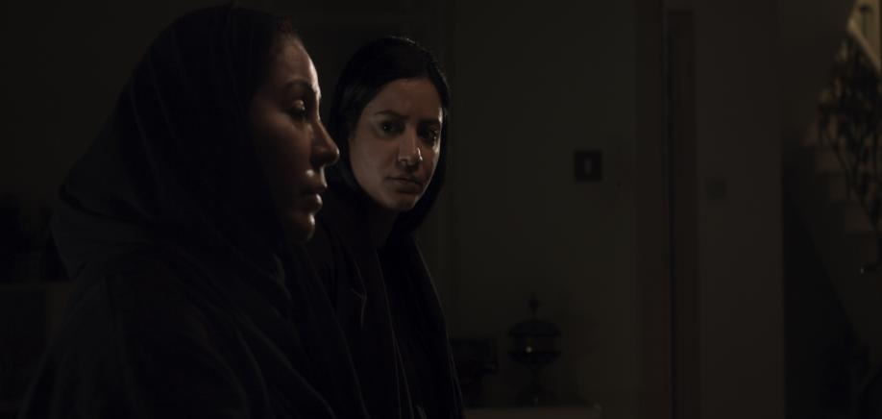
Logline
An Emirati young lady’s dream of becoming an actress, but her dreams clashes with her conservative family’s efforts to get her married.

Slide 5
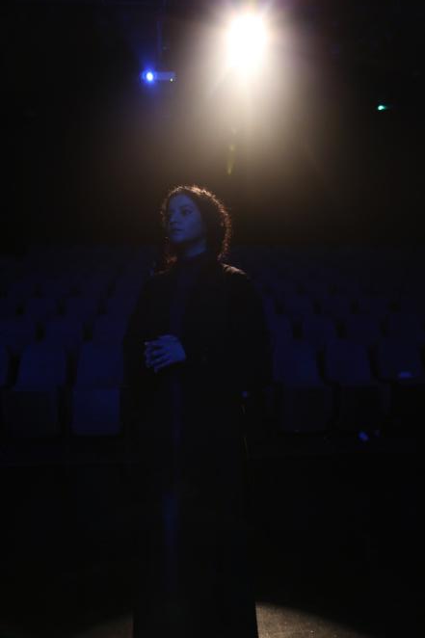
Synopsis
Maryam Abdullah is planning on leaving the UAE and moving to New York to study acting.
Her Mother is forcing her to get married and start a family, instead of wasting her time on an ‘unrealistic and meaningless dream’.
While fighting for her ‘life’, Maryam’s passion and ambitions quickly evaporate when her father, and her sole champion, suddenly passes away.

Slide 6
Director’s statement
This movie represents every girl/young lady/woman in the Arab world. There are many women who want the right to follow their passion and pursue their freedom in all aspects of life but are hindered by both family and society at large.
A young lady like MARYAM who wants to pursue her dream as an actress could be seen as a shameful behavior in a conservative Arab society. The norm is sticking to the traditional road in life by getting married and raising a family.
I think the audience, especially women, will tend to be more involved in the story, by choosing the angle from which they look at the film and connect to their own life and passion.

Slide 7
Movie stills

Slide 8
Movie stills

Slide 9
Movie stills

Slide 10
Movie stills

Slide 11
Credits
Cast
FATIMA AL TAEI AS MARYAM
HUDA ALGHANEM AS THE MOTHER
KHALED DIAB AS THE FATHER
ASHED HASAN AS JASIM ‘THEATER DIRECTOR’
Mohannad Azizah AS ELIE
MERAL NIAZI AS AYESHA
NOURA ALABED AS FATIMA
Majed Alzubaidi AS THE ACTING TEACHER|
SONIYA GOEL AS THEATER STUDENTS
KANISHKA GOEL AS THEATER STUDENTS
SHANIKA PERERA AS THEATER STUDENTS
MOHIT RUPPELL AS THEATER STUDENTS
Crew
SAAD ALDIN ALKHAROUF Director of Photography
MEHDI OUHAMMOU Editor
AIHAM ALSUBAIHI Assistant Director
EHSAN PARHAM AL AWADHI 1st Camera Assistant
DILLON JOEL LOBO 2ND Camera Assistant
MARC PASCUAL Gaffer
GHAFFAR ABBAS Spark
RUEL S.VILLALOBOS Grip
JULIAN PAPAGHIUC Colorist
ASKERA FAUNOV DIT
SUNIL SHA Production sound mixer
SHAUN FROES Sound Designer
JOHN KOCHANCZYK Sound Supervising Editor
TINA AL TAIE Continuity
SANDHYA-LALLO-MORAR Costume Designer
TARIQ ABDALLA Graphic Designer
AYSHA SAIF AL HEMRANI Storyboard artist
YASMIN AL AMEERI Wardrobe Assistant
RUCHIRA THAKUR Wardrobe Assistant
HANIEH KIANI Wardrobe Assistant
TINA AL TAIE PROPS ASSISTANT
AMAL AL DUWAILA Script Supervisor
PIERRICK LE BOURDIEC Art Director
FARIDA ABDELAAL Production assistant
AHMED AL MULLA Set Photographer
NADA PASCALE MATAR Production Manager/MakeUp
SUHAIB ABDULLAH Script Translation
FARIDA ABDELAAL Behind the scene videographer

